Slide 1

1st Grade
Ms. Goodwin, Rm 134
2020-2021

Slide 2
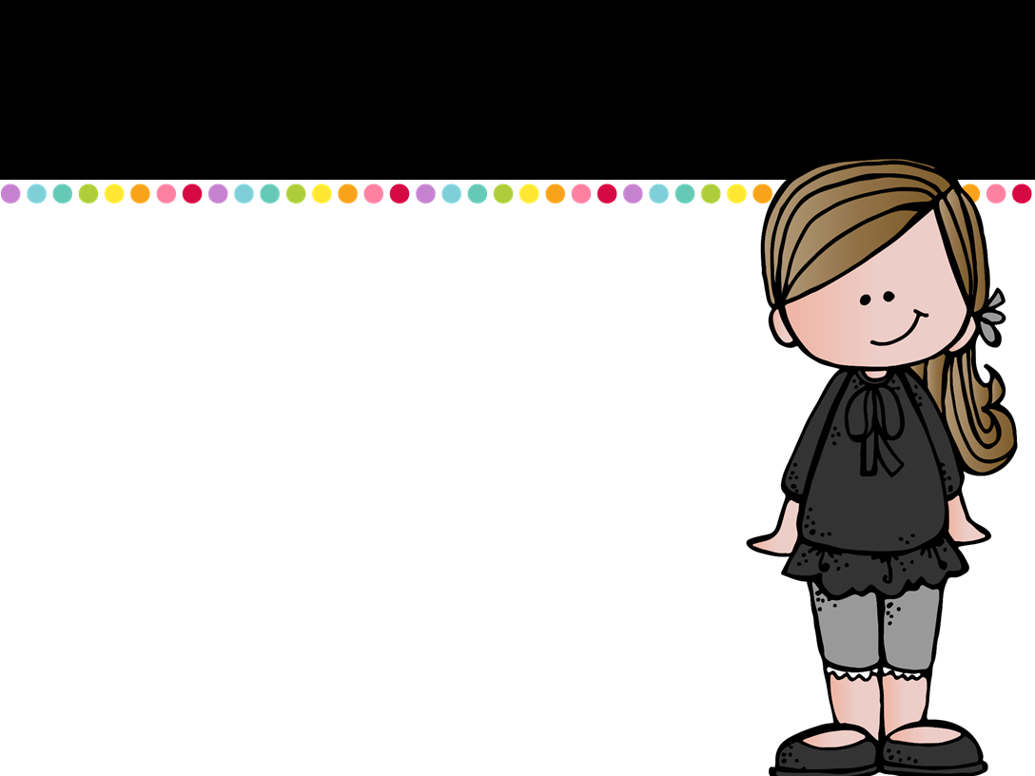
Meet the Teacher
Hello! I am Ms. Goodwin and I will be your 1st grade teacher this year. I have been teaching for 12 years. I live with my sweet, rescue dog Zoey. I also teach with the MATS afterschool program. I love spending time with friends and family and enjoy Alabama Football! I am excited to get to know all of you, and look forward to a great year regardless of the circumstances!

Slide 3

Classroom Rules
Rule #1- Listen when your teacher is talking.
Rule #2- Follow directions quickly.
Rule #3- Keep hands and feet to yourself.
Rule #4- Raise your hand to speak or stand.
Rule #5- Be safe. Be kind. Be honest.

Slide 4

Daily Schedule
8:00-10:30 Morning work/
Reading/Writing/Phonics
10:30-10:45
Read Aloud/Character Education
10:50-11:20 Lunch
11:25-12:25 Math
12:25-12:55 Science
12:55-1:25 Social Studies
1:30-1:45 Snack
1:50-2:20 P.E.

Slide 5

Procedures
Please check your child’s take home folder daily! This is where their behavior chart, special announcements and homework for the week will be. All homework is due on Friday of each week.
Please initial your child’s behavior chart daily!
We will use Class Dojo for Behavior Management. We will send home a letter about how to join on Monday.

Slide 6

Important Reminders
Due to Covid-19 restrictions, parents may not enter the building, not even the first day of school. As a parent, I know this is hard but please know they are in good hands!
Masks are not required for first graders but we do recommend your child wear a mask to school every day.
You may send a snack with your child if you choose to but please no candy or caffeinated drinks!
You may send a water bottle with your child since no one may drink from the water fountains during this time. Please label them!

Slide 7

Teacher Contact
Phone #:
342-2654
Email:
ggoodwin@tcss.net
Class Dojo
*Please never hesitate to call, email, or send a message on class dojo if you have any questions or concerns!

